Slide 1

Python OOP Concepts

Slide 2

Manishkumar R Solanki
Sr. Lecturer, Information Technology,
manish_ratilal2002@yahoo.com
SBMP

Slide 3
Students will be able to:
Write class oriented scripts

Slide 4
Writing classes in Python

Slide 5
class & object
Object-oriented programming (OOP) is a method of structuring a program by bundling related properties and behaviors into individual objects.
OOP models real-world entities as software objects that have some data associated with them and can perform certain functions.
For instance, an object could represent a product with properties like a code, name, quantity and price and behaviors such as price update, quantity update, sales, etc.
A class is a user defined data type. It acts as a “template” or “blue print” or “dye” which defines the attributes and behaviors. It is a logical reality. From a class we can create n number of physical instances(objects)

Slide 6
class oriented keywords
There are some terms which you need to know while working with classes in Python.
The “class” keyword
The “self” keyword
The “__init_” method
The class attributes
The instance attributes

Slide 7
class oriented keywords
The “Class” Keyword :With the class keyword, we can create a Python class.
Syntax: class ClassName:
'Optional class documentation string'
class_body
The class has a documentation string, which can be accessed via ClassName.__doc__.
The class_body defines class members, data attributes and functions.
Example
class BookStore:
pass # if we don’t want to write body at present

Slide 8
class oriented keywords
2. Self keyword
Python provides the “self” keyword to represent the instance of a class which invokes the method.
It is implicitly the first argument to the __init__ method in every Python class.
Note: It is equivalent to the this pointer in C++ and the this reference in Java and C#.
3.__init__ ( ) = constructor in Python
The “__init__()” is a unique method associated with every Python class.
Python calls it automatically for every object created from the class. Its purpose is to initialize the class attributes with user-supplied values.
It is commonly known as Constructor in object-oriented programming.

Slide 9
class oriented keywords
Example:
class BookStore:
def __init__(self):
print("Welcome to __init__() constructor...")
#(instance)object creation
B1 = BookStore()
Welcome to __init__() constructor...

Slide 10
class oriented keywords
4.The Instance Attributes
These are object-specific attributes defined as parameters to the __init__ method.
Each object can have different values for themselves.
class BookStore:
def __init__(self,title,author,qty,price):
print("Welcome to __init__() constructor...")
self.title=title
self.author=author
self.qty=qty
self.price=price
#(instance)object creation
B1 = BookStore("Python Programming","Andrew NG",20,350)

Slide 11
class oriented keywords
5. The Class Attributes
The class attributes are not created per instance rather only a single copy is created of these variables. These attributes are being shared by all objects.
class BookStore:
TotalBooks=0
def __init__(self,title,author,qty,price):
print("Welcome to __init__() constructor...")
self.title=title
self.author=author
self.qty=qty
self.price=price
BookStore.TotalBooks+=1
#(instance)object creation
B1 = BookStore("Python Programming","Andrew NG",20,350)
print("Total Books=",BookStore.TotalBooks)
B2 = BookStore("ANSI C","E Balagurusamy",50,300)
print("Total Books=",BookStore.TotalBooks)
Welcome to __init__() constructor...
Total Books= 1
Welcome to __init__() constructor...
Total Books= 2

Slide 12
Introducing a member function
class BookStore:
TotalBooks=0
def __init__(self,title,author,qty,price):
print("Welcome to __init__() constructor...")
self.title=title
self.author=author
self.qty=qty
self.price=price
BookStore.TotalBooks+=1
def getBook(self):
print("Title=",self.title)
print("author=",self.author)
print("Quantity=",self.qty)
print("Price=",self.price)

Slide 13
Introducing a member function
#(instance)object creation
b1 = BookStore("Python Programming","Andrew NG",20,350)
print("Total Books=",BookStore.TotalBooks)
b2 = BookStore("ANSI C","E Balagurusamy",50,300)
print("Total Books=",BookStore.TotalBooks)
print("Book1 Details:")
b1.getBook()
print("Book2 Details:")
b2.getBook()
Welcome to __init__() constructor...
Total Books= 1
Welcome to __init__() constructor...
Total Books= 2
Book1 Details:
Title= Python Programming
author= Andrew NG
Quantity= 20
Price= 350
Book2 Details:
Title= ANSI C
author= E Balagurusamy
Quantity= 50
Price= 300

Slide 14
Practice Question
Q1: Modify the BookStore program to calculate total valuation and develop member methods to update price and quantity of a book.
Q2:Write a Python script to perform addition of 2 complex numbers and display all complex numbers.

Slide 15
Addition of 2 Complex Numbers
class Complex:
def __init__(self, r=0, i=0):
self.real = r
self.imag = i
def get_data(self):
print(f'{self.real}+{self.imag}j')
def add_comp(self,c2):
ans=Complex()
ans.real=self.real+c2.real
ans.imag=self.imag+c2.imag
return ans
# Creating objects and invoking member #methods
c1=Complex(2,3)
print("Complex Number 1",end='=')
c1.get_data()
c2=Complex(4,5)
print("Complex Number 2",end='=')
c2.get_data()
c3=c1.add_comp(c2)
print("Resultant Complex Number",end='=')
c3.get_data()

Slide 16
Addition of 2 Complex Numbers
Complex Number 1=2+3j
Complex Number 2=4+5j
Resultant Complex Number=6+8j

Slide 17
If a class name is of single word then the first letter is capital and if it is of multiple words then the first letter of every word is capital (like Java)

Slide 18
Built-In Class Attributes
Every Python class keeps following built-in attributes and they can be accessed using dot operator like any other attribute:
__dict__ − Dictionary containing the class's namespace.
__doc__ − Class documentation string or none, if undefined.
__name__ − Class name.
__module__ − Module name in which the class is defined. This attribute is "__main__" in interactive mode.
__bases__ − A possibly empty tuple containing the base classes, in the order of their occurrence in the base class list.

Slide 19
Built-In Class Attributes
class Demo:
""" Demo class"""
def __init__(self,a,b):
self.a=a
self.b=b
d1=Demo(2,3)
#print(Demo.__doc__)
#print(Demo.__name__)
print(Demo.__dict__)
print(d1.__dict__)
#print(Demo.__module__)
#print(Demo.__bases__)
{'__module__': '__main__', '__doc__': ' Demo class', '__init__': <function Demo.__init__ at 0x00000174B5625F70>, '__dict__': <attribute '__dict__' of 'Demo' objects>, '__weakref__': <attribute '__weakref__' of 'Demo' objects>}
{'a': 2, 'b': 3}

Slide 20
Destructor
On the command del obj, the binding is removed and the name obj is deleted from the corresponding namespace.
The object however continues to exist in memory and if no other name is bound to it, it is later automatically destroyed.
This automatic destruction of unreferenced objects in Python is also called garbage collection.
A class can implement the special method __del__(), called a destructor, that is invoked when the instance is about to be destroyed.
This method might be used to clean up any non memory resources used by an instance.

Slide 21
Destructor
class Demo:
""" Demo class"""
def __init__(self,a,b):
self.a=a
self.b=b
def __del__(self):
print ("Object destroyed")
d1=Demo(2,3)
d2=Demo(4,5)
del d1
del d2
Object destroyed
Object destroyed

Slide 22
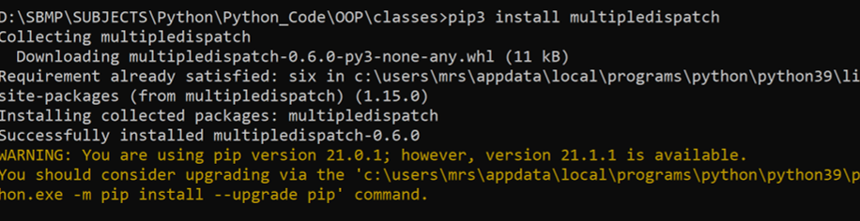
Method Overloading
By default, Python doesn’t support “Method Overloading.”
We have to install multipledispatch package

Slide 23
Method Overloading
from multipledispatch import dispatch
@dispatch(int,int)
def multiply(a,b):
print("Welcome to 2 params of int type")
result = a*b
print(result)
@dispatch(int,int,int)
def multiply(a,b,c):
print("Welcome to 3 params of int type")
return (a*b*c)
@dispatch(float,float,float)
def multiply(a,b,c):
print("Welcome to 3 params of float type")
print(a * b * c)
# Invoking methods
multiply(5,6)
multiply(2.2,3.4,2.3)
print(multiply(2,3,2))
Welcome to 2 params of int type
30
Welcome to 3 params of float type
17.204
Welcome to 3 params of int type
12

Slide 24
Array of objects
Array of objects can be implemented by list data type.
#Array of objects
books=[]
print("How many books you want to enter?")
n=int(input())
for i in range(n):
print("Enter title,author,quantity and price of book",i+1)
title=input()
author=input()
qty=int(input())
price=float(input())
books.append(BookStore(title,author,qty,price))
# Displaying book details
#for i in range(len(books)):
#books[i].getBook()
for book in books:
print(book)
book.getBook()

Slide 25
Operator Overloading in Python

Slide 26
Operator Overloading
Python operators behaves differently with different types. For example, the + operator will perform arithmetic addition on two numbers, merge two lists, or concatenate two strings.
This feature in Python that allows the same operator to have different meaning according to the context is called operator overloading.

Slide 27
Operator Overloading
By default, Python doesn’t allow operator overloading on user defined class objects:
class Point:
def __init__(self, x=0, y=0):
self.x = x
self.y = y
p1 = Point(1, 2)
p2 = Point(2, 3)
print(p1+p2)
D:\SBMP\SUBJECTS\Python\Python_Code\OOP\classes>python point.py
Traceback (most recent call last):
File "D:\SBMP\SUBJECTS\Python\Python_Code\OOP\classes\point.py", line 9, in <module>
print(p1+p2)
TypeError: unsupported operand type(s) for +: 'Point' and 'Point'

Slide 28
Class functions that begin with double underscore __ are called special functions in Python.

Slide 29
Displaying object information
class Point:
def __init__(self, x=0, y=0):
self.x = x
self.y = y
p1 = Point(1, 2)
print(p1)
<__main__.Point object at 0x000001D556431760>

Slide 30
To print the coordinates of the Point object, we can define a __str__() method in our class that controls how the object gets printed. [Like toString() method of Object class in Java]

Slide 31
Displaying object information
class Point:
def __init__(self, x=0, y=0):
self.x = x
self.y = y
def __str__(self):
return "({0},{1})".format(self.x,self.y)
p1 = Point(1, 2)
print(p1)
(1,2)

Slide 32
Overloading binary + operator
class Point:
def __init__(self, x=0, y=0):
self.x = x
self.y = y
def __str__(self):
return "({0},{1})".format(self.x,self.y)
def __add__(self, other):
x = self.x + other.x
y = self.y + other.y
return Point(x, y)
p1=Point(2,3)
p2=Point(4,5)
print(p1+p2)
(6,8)

Slide 33
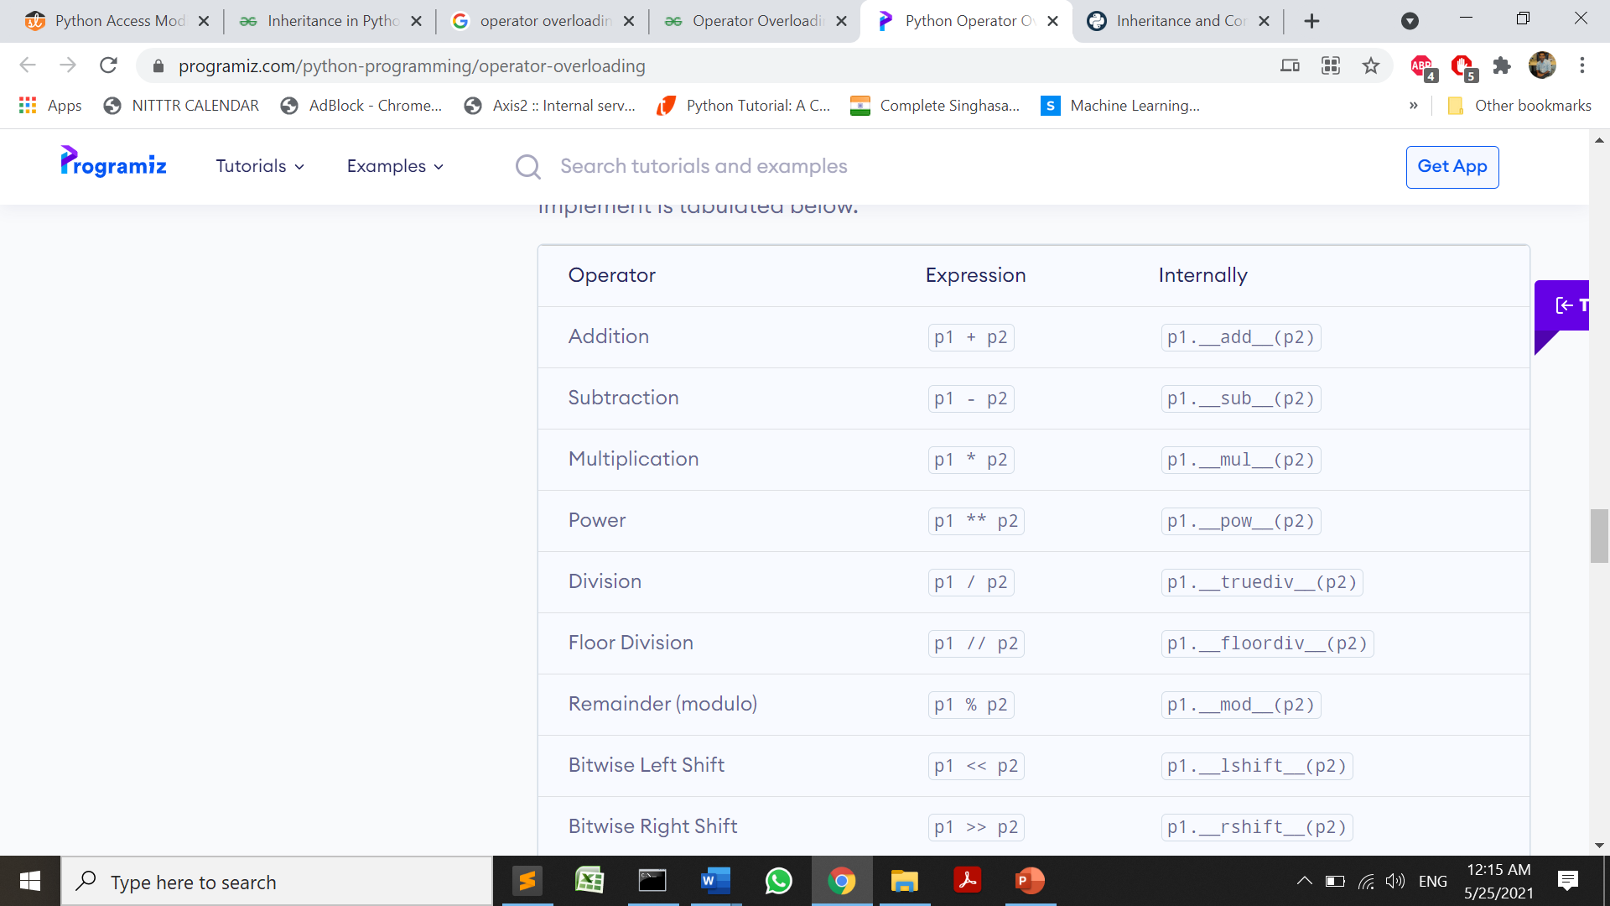
Overloading methods

Slide 34
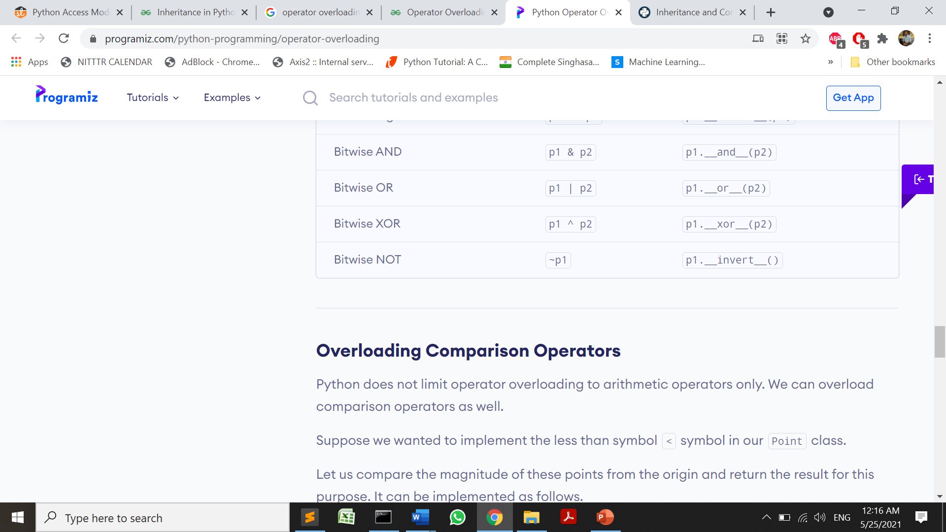
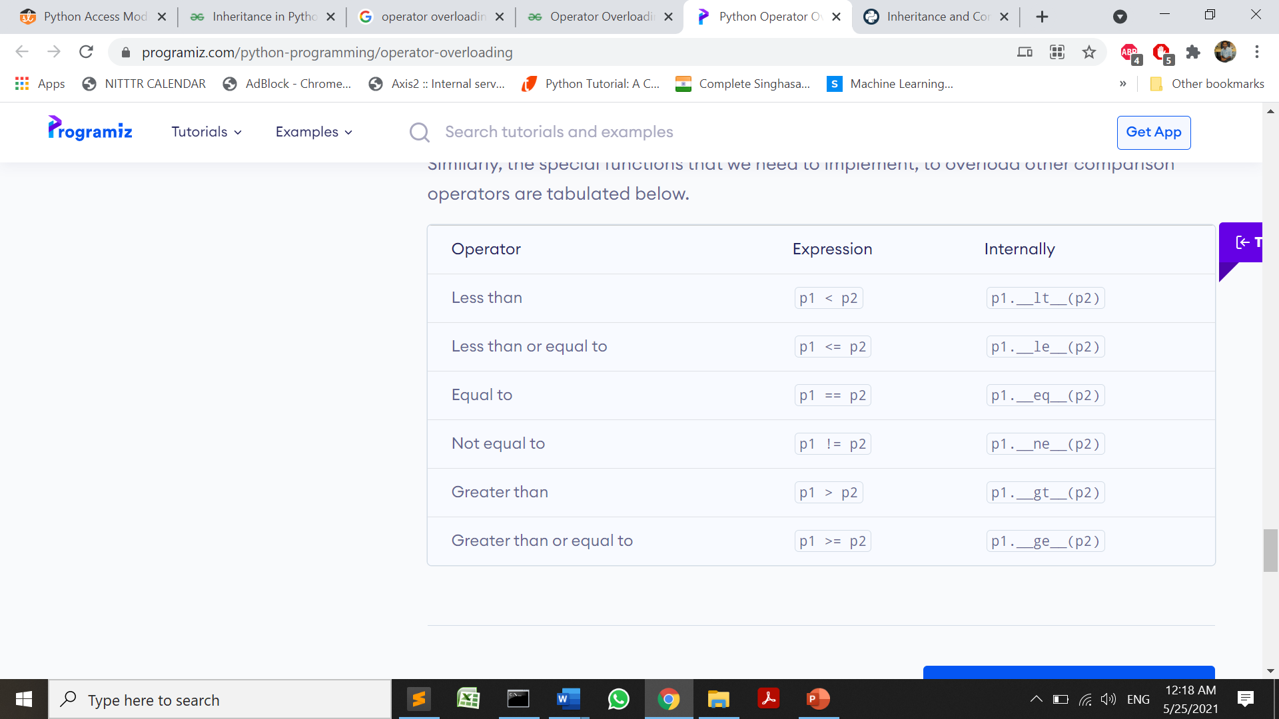
Overloading methods

Slide 35
Overloading < operator
class Point:
def __init__(self, x=0):
self.x = x
def __lt__(self, other):
if (self.x < other.x):
return True
else:
return False
p1 = Point(1)
p2 = Point(-2)
p3 = Point(3)
# use less than
print(p1<p2)
print(p2<p3)
print(p1<p3)
False
True
True

Slide 36
Inheritance in Python

Slide 37
Inheritance
One class derives properties of another class plus it is having its unique properties as well.
Advantages of Inheritance:
Represents real world relationship well
Provides Reusability

Slide 38
Inheritance Syntax
class BaseClass:
Body of base class
class DerivedClass(BaseClass):
Body of derived class

Slide 39
Inheritance Example
class Person:
# Constructor
def __init__(self, name,age):
self.name = name
self.age= age
# To get name
def getName(self):
return self.name
def getAge(self):
return self.age
# Inherited or Subclass
class Employee(Person):
def __init__(self, name,age,code,exp):
super().__init__(name, age)
self.code = code
self.exp= exp
# To get name
def getCode(self):
return self.code
def getExp(self):
return self.exp

Slide 40
Inheritance Example
# Testing class capability
p1 = Person("Kevin",25) # An Object of Person
print("Person Name=",p1.getName(),"\n","Person Age=", p1.getAge())
e1 = Employee("Nitin",30,121,5) # An Object of Employee
print("Emp Name=",e1.getName(),"\n","Emp Age=", e1.getAge())
print("Emp Code=",e1.getCode(),"\n","Emp experience=",e1.getExp())
Person Name= Kevin
Person Age= 25
Emp Name= Nitin
Emp Age= 30
Emp Code= 121
Emp experience= 5

Slide 41
Inheritance Practice Question
Derive a student class from a person class, having id, name, semester and marks of 2 subjects as data members . Develop a method to calculate the average marks of a student.

Slide 42
Access Specifiers
Python makes the use of underscores to specify the access modifier for a specific data member and member function in a class.
public: Accessible from outside the class through an object of the class.
protected: Accessible from only in a class derived from it that is in the child or subclass.
private: Only accessible from within the class. No outside access is allowed.

Slide 43
By default, all the variables and member functions of a class are public in a python program.

Slide 44
Access Specifiers
public: Accessible from outside the class through an object of the class.
# defining a class Employee
class Employee:
# constructor
def __init__(self, name, sal):
self.name = name;
self.sal = sal;

Slide 45
Access Specifiers
2. protected: Accessible from only in a class derived from it that is in the child or subclass.
Adding a prefix _(single underscore) to a variable name makes it protected.
# defining a class Employee
class Employee:
# constructor
def __init__(self, name, sal):
self._name = name; # protected attribute
self._sal = sal; # protected attribute

Slide 46
Access Specifiers
3. private: Only accessible from within the class. No outside access is allowed.
Addition of prefix __(double underscore) results in a member variable or function becoming private.
# defining class Employee
class Employee:
def __init__(self, name, sal):
self.__name = name; # private attribute
self.__sal = sal; # private attribute
https://www.studytonight.com/python/access-modifier-python

Slide 47
Python supports the following Inheritances:
# Single/Simple
# Multi-level
# Multiple
# Hierarchical
# Hybrid

Slide 48
Syntax for Multiple Inheritance:
class A (B, C):
# body

Slide 49
Method Overriding in Python

Slide 50
Method Overriding
Method overriding allows a subclass or child class to provide a specific implementation of a method that is already provided by one of its super-classes.
When a method in a subclass has the same name, same parameters or signature and same return type as a method in its super-class, then the method in the subclass is said to override the method in the super-class.

Slide 51
Method Overriding
class Parent():
# Constructor
def __init__(self):
self.value = "Inside Parent"
# Parent's show method
def show(self):
print(self.value)
# Defining child class
class Child(Parent):
# Child Constructor
def __init__(self):
self.value = "Inside Child"
# Child's show method
def show(self):
print(self.value)
# Testing Code
ob1 = Parent()
ob2 = Child()
ob1.show()
ob2.show()
Inside Parent
Inside Child
Note: The object which invokes the method, the reference of that object
is passed to self.

Slide 52
The parent class’s method, can be invoked by 2 ways:
1. Parent_Class_name.method_name()
2. super().method_name()

Slide 53
The object which invokes the method, the reference of that object
is passed to self.

Slide 54
Interface in Python

Slide 55
Interfaces
An interface acts as a template for designing classes.
Interfaces also define methods the same as classes, but abstract methods, whereas class contains nonabstract methods.
Abstract methods are those methods without implementation or which are without the body.
The implementation of these abstract methods is defined by classes that implement an interface.
NOTE:
Python doesn’t use keyword “interface” as other languages i.e. C#, Java and Go
Python does not require that a class which is implements an interface has to provide the definition for all the abstract methods of an interface.

Slide 56
Interfaces
There are two ways for creating and implementing the interface in python are:
1.Informal Interface
2.Formal Interface
Informal Interface :
Python informal interface is also a class that defines methods that can be overridden but without force enforcement. An informal interface also called Protocols
It is mostly defined by templates or demonstrates in the documentations.
Some of the methods we used i.e. __len__, __iter__, __contains__ and all, which are used to perform some operation or set of protocols.

Slide 57
Informal Interface
class Fruits :
def __init__( self, ele):
self.__ele = ele
def __contains__( self, ele):
return ele in self.__ele
def __len__( self ):
return len( self.__ele)
def __iter__( self):
return self
Fruits_list = Fruits([ "Apple", "Banana", "Orange" ])
# protocol to get size
print(len(Fruits_list))
# protocol to get container
print("Apple" in Fruits_list)
print("Mango" in Fruits_list)
print("Orange" not in Fruits_list)
3
True
False
False

Slide 58
Formal Interface
2. Formal Interface :
A formal interface is an interface which enforced formally.(It is compulsory for the derived class to provide body of abstract method defined by interface)
For creating a formal interface we need to use ABCs(Abstract Base Classes).
The ABCs is explained as we define a class that is abstract in nature, we also define the methods on the base class as abstract methods.
Any object we are deriving from the base classes is forced to implement those methods.

Slide 59
Formal Interface Example
import abc
class Figure (abc.ABC):
#@abc.abstractmethod
def area( self ):
pass
class Rectangle(Figure):
def __init__(self,d1,d2):
self.d1=d1
self.d2=d2
def area(self):
return self.d1*self.d2
def getDim(self):
print("length=",self.d1)
print("breadth=",self.d2)
r = Rectangle(2,5)
#print( isinstance(r, Figure))
r.getDim();
print("Area of a Rectangle=",r.area())
length= 2
breadth= 5
Area of a Rectangle= 10

Slide 60
Abstract Class in Python
Write a python program to demonstrate the working of an abstract class

Slide 61
import abc
class Figure (abc.ABC):
def __init__(self,d1,d2):
self.d1=d1
self.d2=d2
#@abc.abstractmethod
def area( self ):
pass
def demo(self):
print("Hello")
class Rectangle(Figure):
def __init__(self,d1,d2):
super().__init__(d1,d2)
def area(self):
return self.d1*self.d2
def getDim(self):
print("length=",self.d1)
print("breadth=",self.d2)
r = Rectangle(2,5)
#print( isinstance(r, Figure))
r.getDim();
print("Area of a Rectangle=",r.area())
r.demo()
Abstract Class in Python
length= 2
breadth= 5
Area of a Rectangle= 10
Hello

Slide 62
Method Resolution Order(MRO)
MRO is a concept used in inheritance.
It is the order in which a method is searched for in a classes hierarchy.
In Python, the MRO is from bottom to top and left to right.
At first, the method is searched in the class of the object.
If it’s not found, it is searched in the immediate super class.
In the case of multiple super classes, it is searched left to right.

Slide 63
Method Resolution Order(MRO)
Example:
class A:
def method(self):
print("A.method() called")
class B(A):
def method(self):
print("B.method() called")
b = B()
b.method()
B.method() called

Slide 64
Method Resolution Order(MRO)
class A:
def method(self):
print("A.method() called")
class B:
pass
class C(B, A):
pass
c = C()
c.method()
A.method() called

Slide 65
References
https://www.programiz.com/python-programming/class
https://www.programiz.com/python-programming/operator-overloading
https://www.geeksforgeeks.org/method-overriding-in-python/
Interface concept: https://www.educba.com/interface-in-python/
https://pythonguides.com/python-interface/
Iterator:https://www.tutorialgateway.org/python-iterator/
https://www.educative.io/edpresso/what-is-mro-in-python

Slide 66
By the end of this tutorial you will be able to:
Define what is a class
Describe how to create a class
Define what is a method
Describe how to do object instantiation
Describe how to create instance attributes in Python

Slide 67
THANKS!
Any questions?
You can find me at
manish_ratilal2002@yahoo.com

